Slide 1
CSS Measurements
By: Jeremy Pratt

Slide 2
What are CSS Measurements
CSS (Cascading Style Sheets) measurements are the units of measurement used in the styling of various programmable applications. Mainly used for HTML Webpages, they consist of Static Measurements and Dynamic Measurements.

Slide 3
Absolute Measurements
Absolute Measurements are measurements which do not change size based on other factors. Static measurements incude:
Cm
In
Mm
Pt
Pc
Px

Slide 4
Relative Measurements
Relative Measurements are measurements which can changed based on other factors such as screen size or set fonts. Dynamic Measurements include:
%
Em
Ex

Slide 5
MM, CM, IN
MM, CM, and IN are commonly used today for measurements in construction, mathematics, and physics. It’s not common to use these with programming, but essential to know.
MM (Millimeters) Millimeters are a small metric unit of measurement. It is equal to 1/10 cm
CM (Centimeters) Centimeters are a metric unit of measurement. It is equal to 10 mm
IN (inches) this is an Imperial Unit of measurement. It is equal to 2.54cm

Slide 6
PX,PT, PC
PX, PT, and PC are units of measurement developed around programming and computer needs.
PX (pixels) this measurement is a unit of size based on number of screen pixels
PT (points) this is a measurement that is described as being 1/72nd of an inch
PC (picas) this measurement is based on points and is equal to 12 points. Thus there are 6 picas per inch.

Slide 7
%, em, ex
%, em, and ex are all measurements that depend on another variable to get their size, whether it be referencing a static measurement first or depending on the size of a screen.
% (percent) this measurement is usally applied as a relative size, such as taking up 50% of a screen, div, or column.
Em is a relative measurement for the height of a font in em spaces. Because an em unit is equivalent to the size of a given font, if you assign a font to 12pt, each "em" unit would be 12pt; thus, 2em would be 24pt
Ex is a value defined by a measurement relative to a font's x-height. The x-height is determined by the height of the font's lowercase letter x.

Slide 8
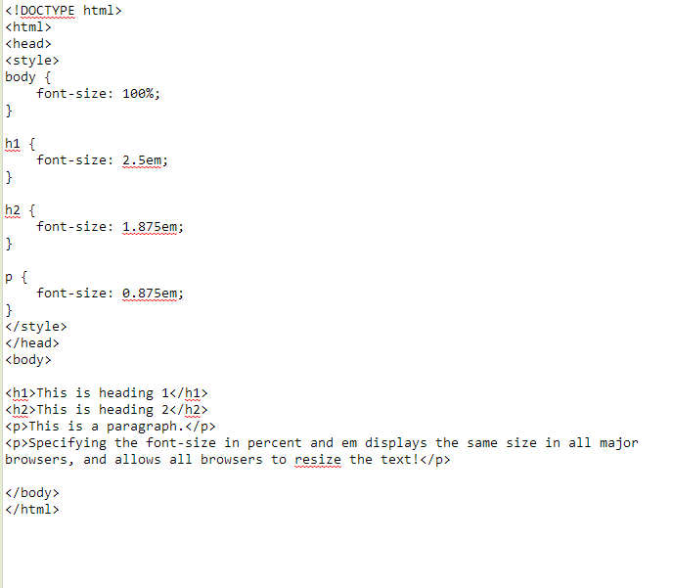
Example (code)

Slide 9
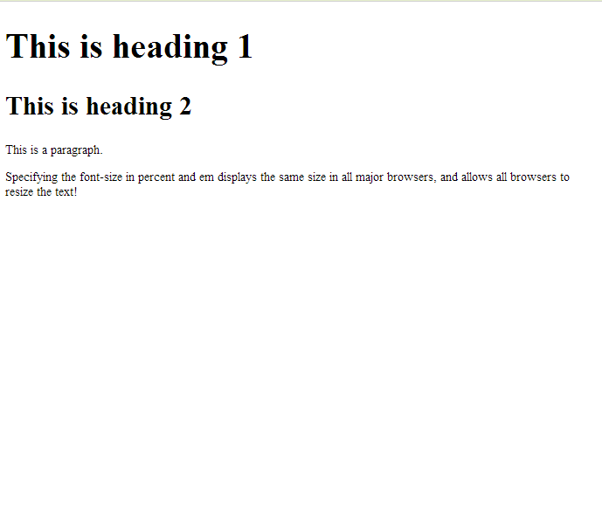
Example (display)

